Slide 1
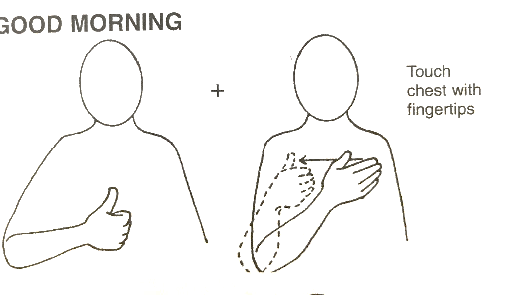
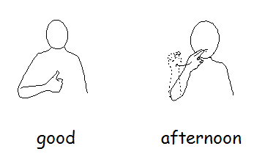
 | Week 4
 | Good morning | Good afternoon | Toilet
Toilet
Good morning
Good afternoon

