Slide 1
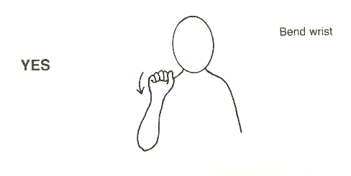
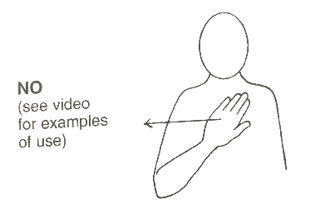
 | Week 3
 | Help | Yes | No
Yes
No
Help

