Slide 1
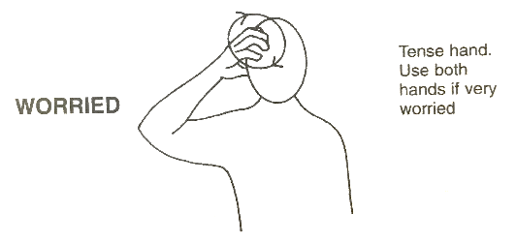
 | Week 10
 | Worried | First | Next
Next
Worried
First

